Slide 1
SPEECH RECOGNITION WITH DEEP RECURRENT NEURAL NETWORKS
BY-700757079

Slide 2
Motivation
The growing importance and applications of speech recognition technology.
The potential of Recurrent Neural Networks (RNNs) for sequential data. Previous successes of RNNs in other fields like handwriting recognition.
The need to enhance RNN performance in speech recognition.

Slide 3
Problem Statement
Limitations of existing models such as Hidden Markov Models (HMM) and deep feedforward networks in speech recognition.
The challenge of RNNs not performing as well as deep feedforward networks in speech recognition.
The need for models that can better handle sequential data and utilize long-range context.

Slide 4
Objectives
To explore the effectiveness of deep Recurrent Neural Networks (RNNs) in speech recognition.
To investigate end-to-end training methods for RNNs.
To achieve state-of-the-art results on speech recognition benchmarks.

Slide 5
Contributions
Introduction of deep Long Short-term Memory (LSTM) RNN architecture.
Combining the multiple levels of representation in deep networks with the flexible use of long-range context in RNNs.
Achieving a test set error of 17.7% on the TIMIT phoneme recognition benchmark.

Slide 6
Results
Dataset & Setup: Used the TIMIT corpus with 462 speakers for training, 50 for development, and 24 for testing. Input vectors had 123 features and were normalized.
Network Variants: Evaluated nine RNNs varying in training methods (CTC, Transducer, pretrained Transducer), hidden levels (1-5), and LSTM cells.
Performance Improvements: Increasing hidden levels in CTC networks reduced phoneme error rate (PER) from 23.9% to 18.4%.
LSTM Superiority: LSTM cells performed significantly better than tanh units, with bidirectional LSTMs slightly outperforming unidirectional ones.

Slide 7

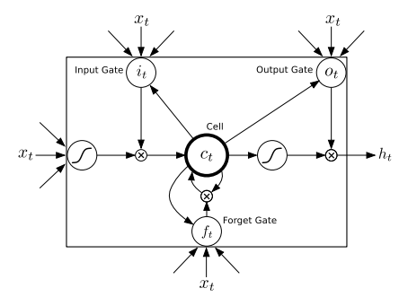
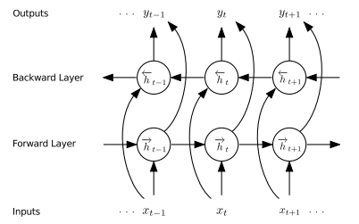
Long Short-term Memory Cell
Bidirectional RNN

Slide 8

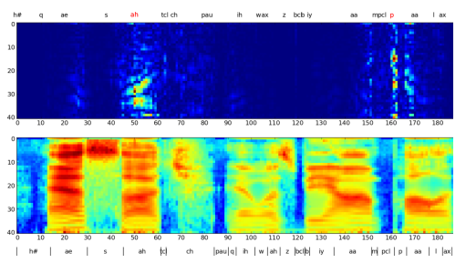
Sensitivity of a Deep CTC RNN:
Top Heatmap: Shows how the 'ah' and 'p' sounds respond to input changes.
Bottom: Input sounds used by the model.
Middle: Actual sound segments from the TIMIT dataset.
Observation: The model's sensitivity spreads to nearby sounds because it tries to learn language patterns directly from the sounds.

Slide 9
Critical Analysis
Strengths of the deep LSTM RNN approach.
Limitations and potential areas for improvement.
Future directions for research in RNN-based speech recognition.

Slide 10
References
Graves, A., Mohamed, A., & Hinton, G. (2013). Speech recognition with deep recurrent neural networks. In Proceedings of the 2013 IEEE International Conference on Acoustics, Speech and Signal Processing (pp. 6645-6649). IEEE. https://doi.org/10.1109/ICASSP.2013.6638947

